Slide 1
Chapter 3
Section 3.1-3.3

Slide 2
Flow Control
In general, the program flow is sequential one statement at a time
But in most cases, the flow needs to changed and the program needs to follow separate branches depending on some conditions
C++ has several such flow control mechanisms

Slide 3
if…else statement
Syntax
if (condition)
{
statements;
}
else
{
statements;
}
The program checks if the condition under the if statement is true
It true execute the block of statements under the if statement, otherwise execute the block of statements under the else condition
Example:
int a=5, b=10;
if (a<b)
cout<<a<<“ is less than “<<b<<endl;
else
cout<<a<<“ is greater than or equal to ”<< b<<endl;

Slide 4
if…else statement
More than two branches are possible by using else if
Example
#include <iostream>
using namespace std;
int main()
{
int my_int;
cout<<"Enter your test score";cin>>my_int;
if (my_int>100 || my_int <0)
cout<<"Input is out of range."<<endl;
else if (my_int<=50)
cout<<"You've failed."<<endl;
else
cout<<"You've passed."<<endl;
return 0;
}

Slide 5
Nesting if…else
if (condition)
{
statement;
if (condition)
{
……………….
……………….
}
else
{
statement;
}
}
else
{
statement;
}

Slide 6
Chapter 3
Section 3.4

Slide 7
Relational Operators
==: Checks if equal
!=: Checks if unequal
>, <, >=,<=: Checks if greater than, lesser than, greater than or equal, less than or equal

Slide 8
Chapter 3
Section 3.5-3.7

Slide 9
Logical Operators
&&: Logical AND, if both operands are non-zero, the result is true
||: Logical OR, if either operand is non-zero, the result is true
!: Logical NOT, reverse the logical state

Slide 10
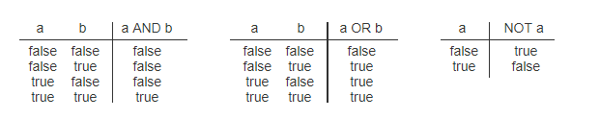
AND, OR and NOT
int a=3,b=4,c=4,d=5;
bool test=(a==c)&&(b<d); // left operand false, right operand true, assigns false to test
bool test2=(a>=d)||(b==c);//left operand false, right operand true, assigns true to test2

Slide 11
Chapter 3
Section 3.8

Slide 12
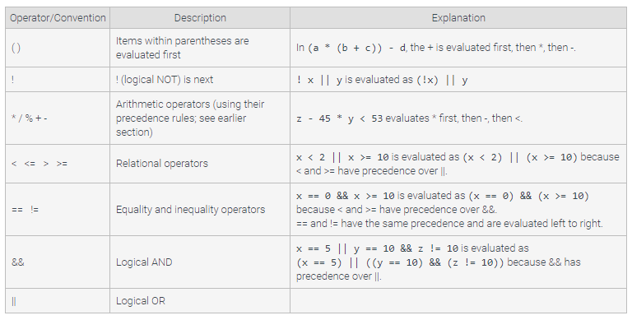
Order of Operations

Slide 13
Chapter 3
Section 3.11

Slide 14
Boolean Type
Special type of variable that can have only two values– true or false (or equivalently non-zero and zero, respectively)
Examples
bool my_condition=true; //declare a Boolean type variable my_condition
// and assign true to it
bool next_condition=false; //declare a Boolean type variable next_condition
//and assign false or zero to it

Slide 15
bool-int Compatibility
The following actions are possible, but generally not recommended
This is a backwards compatibility issue with C
Values of type bool can be assigned to int variables
True is stored as 1
False is stored as 0
Values of type int can be assigned to bool variables
Any non-zero integer is stored as true
Zero is stored as false

Slide 16
Chapter 3
Section 3.10

Slide 17
Switch…case Statement
Controlling expression be of the follows
A bool value
An integer type
A character
The value returned is compared to the constant values after each "case"
When a match is found, the code for that case is used
switch (controlling_expression)
{
case Constant1:
statements;
break;
case Constant2:
statements;
break
……….
……….
default:
statements;
}

Slide 18
The break Statement
The break statement ends the switch statement
Omitting the break statement will cause the code for the next case to be executed!
Omitting a break statement allows the use of multiple case labels for a section of code
case 'A': case 'a': cout << "Excellent."; break;
…
Runs the same code for either 'A' or 'a'

Slide 19
The default Statement
If no case label has a constant that matches the controlling expression, the statements following the default label are executed
If there is no default label, nothing happens when the switch statement is executed
It is a good idea to include a default section
A “catch-all” similar to an “else” statement

Slide 20
Chapter 3
Section 3.12

Slide 21
Enumeration Types
An enumeration type is a type with values defined by a list of constants of type int
Similar to defining your own type
enum Color {Red=1, Blue=2, Green=3}; // enumeration data of type Color
enum Month {January=1, February=2, December=12}; // enumeration data type of type Month
Example:
enum MonthLength {JAN_LENGTH = 31, FEB_LENGTH = 28, MAR_LENGTH = 31, … DEC_LENGTH = 31};

Slide 22
Default enum Values
If numeric values are not specified, identifiers are assigned consecutive values starting with 0
enum Direction {NORTH=0, SOUTH=1, EAST=2, WEST=3}; is equivalent to enum Direction {NORTH, SOUTH, EAST, WEST};
Unless specified, the value assigned an enumeration constant is 1 more than the previous constant
enum MyEnum {ONE = 17, TWO, THREE, FOUR = -3, FIVE}; results in these values
ONE = 17, TWO = 18, THREE = 19, FOUR = -3, FIVE = -2

Slide 23
Chapter 3
Section 3.13

Slide 24
String Comparison: Equality
Two strings are equal if and only if they have identical set of characters in the same order
e.g. “Hello” and “Hello” are equal but “Hello” and “hello” are not
Two strings can be compared using == and != operators

Slide 25
String Comparison: Relational
A string can be compared with another string using the >,<,>= and <= relational operators
Very useful in sorting strings
It is based on the ASCII value of the characters in the string
The comparison is made on the basis of characters starting with the first character
e.g. Hello < hello // ASCII of H=72, ASCII of h=104
hellO<hello // ASCII of H=79, ASCII of h=111

Slide 26
Chapter 3
Section 3.14

Slide 27
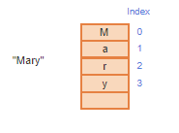
String Access Operations
A string is a sequence of characters
Characters in a string can be accessed by using their indices– location of character in the string
Index starts from 0, not 1
For example, index of character M in Mary is 0, index of character y in Mary is 3

Slide 28
Accessing String Characters
We can use at() function to extract character from strings
For example,
string str=“Hello”;
char my_c=str.at(0);
cout<<my_c; //Displays H
cout<<str.at(3);//Displays l

Slide 29
Chapter 3
Section 3.15

Slide 30
String Operation: length/size
The string class member function length returns the number of characters in the string object:
string my_str="This is a test";
cout<<my_str.size()<<endl; //Displays 14
cout<<my_str.length()<<endl; //Displays 14
cout<<"Enter string:";
cin>>my_str; //User enters This is a test
cout<<my_str.size()<<endl; //Displays 4
cout<<my_str.length()<<endl; //Displays 4

Slide 31
String Operation: append
Concatenates one string to the end of another string
Example
string my_str="This is";
my_str.append("a test");
cout<<my_str<<endl; //Displays This is a test
string add_this=" !!!";
my_str.append(add_this);
cout<<my_str<<endl; //Displays This is a test!!!

Slide 32
String Operation: find
Returns the index of the first occurrence of an item (character or another string) inside a inside a string
Example
string my_str="This is CSCE1030";
int location=my_str.find("CSCE");
cout<<"Location:"<<location<<endl; //Displays 8

Slide 33
String Operation: substr
Extracts part of the string of specified length from specified index
Original string not changed
Example
string my_str="This is CSCE1030";
string my_substr=my_str.substr(8,8);
cout<<my_substr<<endl; //Displays CSCE1030

Slide 34
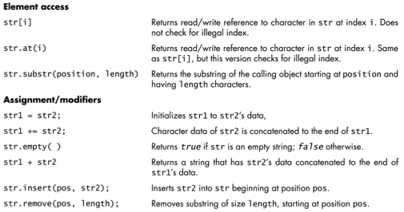
More String Operations

Slide 35
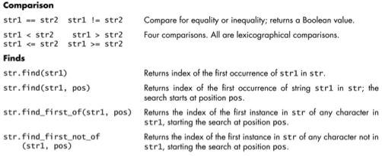
More String Operations

Slide 36
Chapter 3
Section 3.16

Slide 37
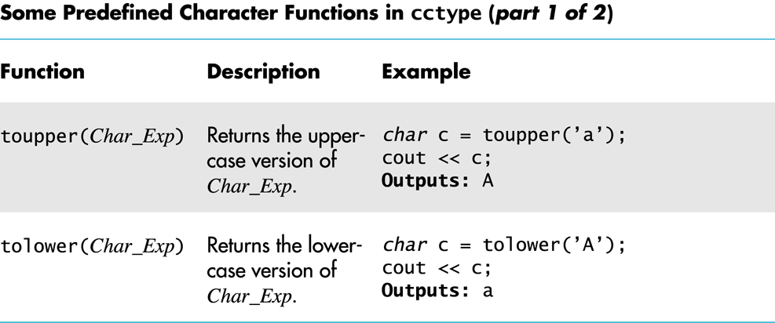
Character Operations

Slide 38
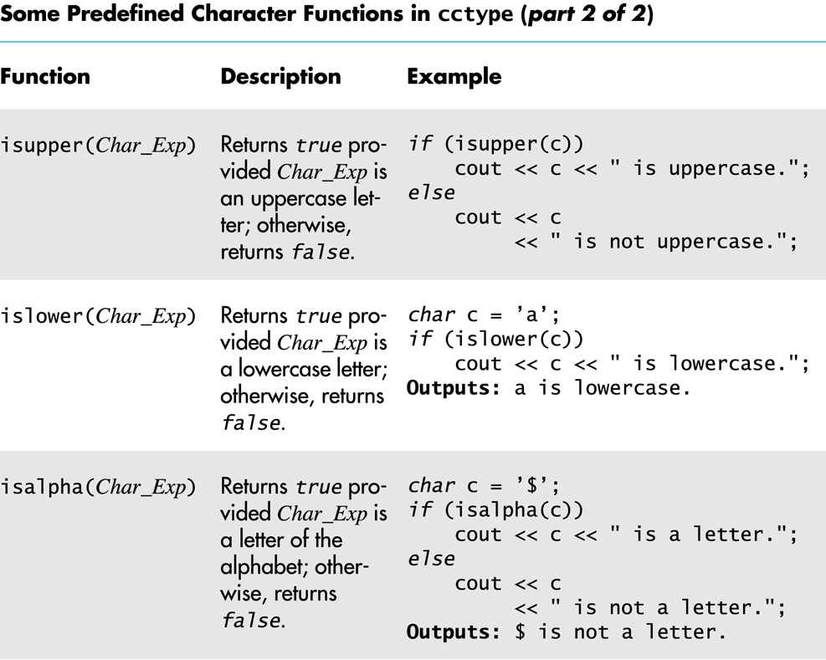
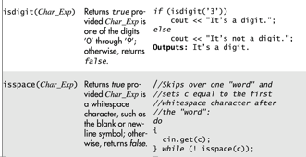
Character Operations

Slide 39
Chapter 3
Section 3.17

Slide 40
Conditional Expressions
condition ? exprWhenTrue : exprWhenFalse
This evaluates the condition and executes exprWhenTrue if true and exprWhenFalse if false
Example
int a=5,b=6;
(a<=b)?cout<<“Smaller number”<<a: cout<<“Smaller number”<<b;
// Compares a and b, and displays the smaller number

Slide 41
Chapter 3
Section 3.18

Slide 42
Floating Point Comparison
Review Zybooks Section 3.12

Slide 43
Chapter 3
Section 3.19

Slide 44
Short-Circuit Evaluation
Some Boolean expressions do not need to be completely evaluated
if x is negative, the value of the expression ((x >= 0) && (y > 1)) can be determined by evaluating only (x >= 0)
C++ uses short-circuit evaluation
If the value of the leftmost sub-expression determines the final value of the expression, the rest of the expression is not evaluated

Slide 45
Using Short-Circuit Evaluation
Short-circuit evaluation can be used to prevent run time errors
Consider this if-statement
if ((kids != 0) && (pieces / kids >= 2)) {
cout << "Each child may have two pieces!”;
}
If the value of kids is zero, short-circuit evaluation prevents evaluation of (pieces / 0 >= 2)
Division-by-zero causes a run-time error

